Slide 1

Weekly Update 14
Sarang Deb Saha

Slide 2
Time frame considered:
Continuous surveillance for a month was done using the ANPR cameras from 21-02-2024 to 20-03-2024.
The api is used to fetch the relevant data in the form of a .json file.
With 1,007,095 unique incidents recorded in the given timespan at 50 intersections in Bengaluru.
https://www.moneycontrol.com/news/technology/why-wednesdays-and-thursdays-are-the-most-congested-in-bengaluru-12317211.html Tells us about the ‘Peak’ and ‘Non-Peak’ hours.
(Weekday peak: 7-11 AM and 4-8 PM
Weekend peak: 11AM-2PM and 6-11PM)

Slide 3
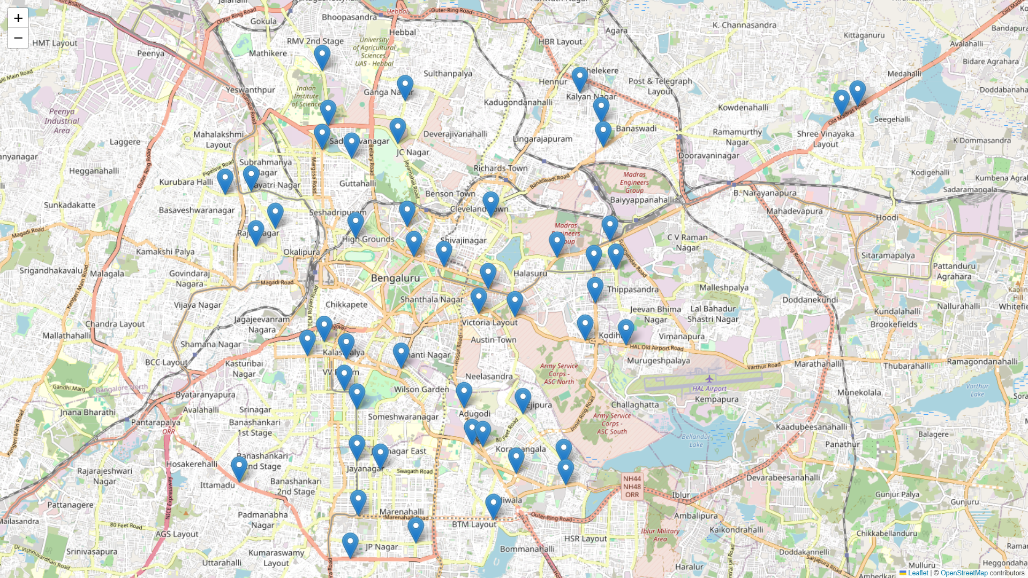
50 intersections considered

Slide 4
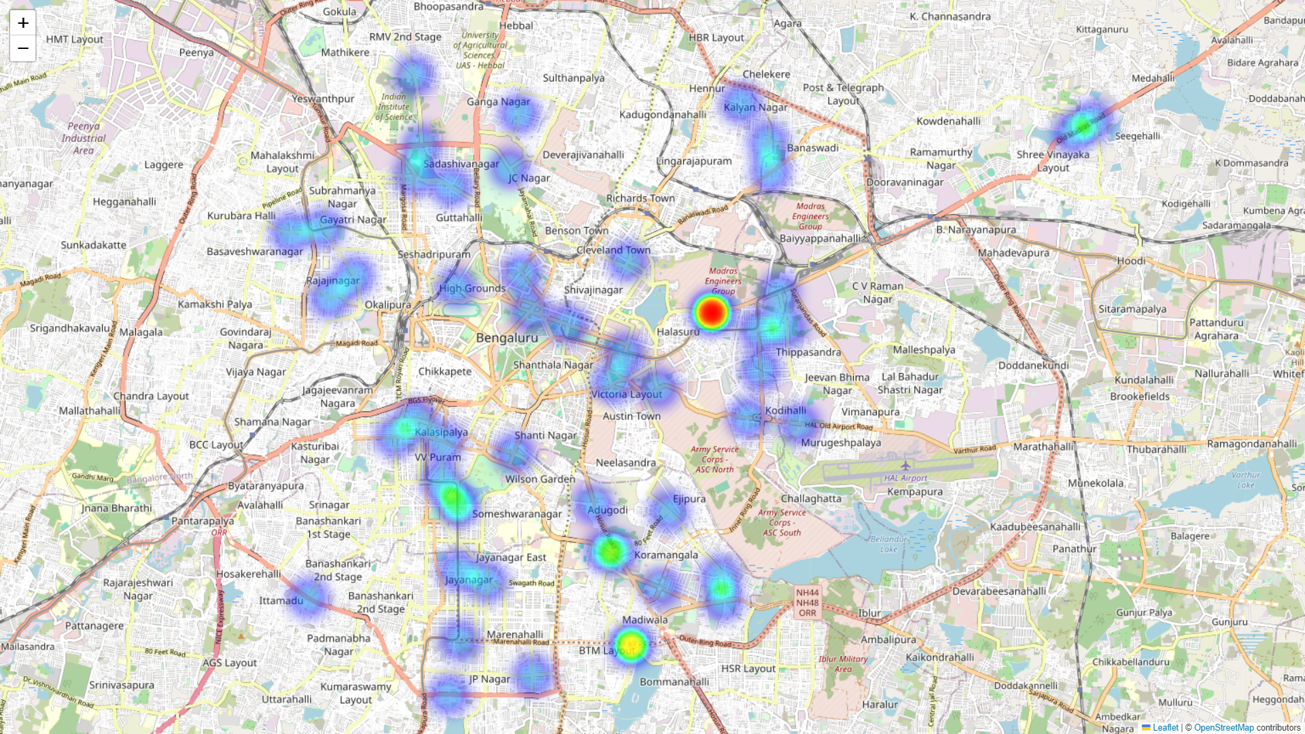
Heatmap of all intersection violations

Slide 5
Summary of Traffic Violation Frequencies
Violation Name | Frequency
RED_LIGHT_VIOLATION_DETECTION | 4,72,861
STOP_LINE_VIOLATION | 2,52,120
VEHICLE_WRONG_WAY | 1,24,085
NO_HELMET | 72,004
NO_SEAT_BELT | 21,841
OVER_SPEED | 21,802
GREEN_LIGHT | 18,241
RED_LIGHT | 18,209
WOMEN_SURROUNDED_BY_MEN | 5,042
DRIVER_ON_CALL | 886
EXPIRED_VEHICLES | 4
NOTE: We observe that a few alerts namely, RED_LIGHT, and GREEN_LIGHT are not exactly violations. Hence we will negate those from our study

Slide 6
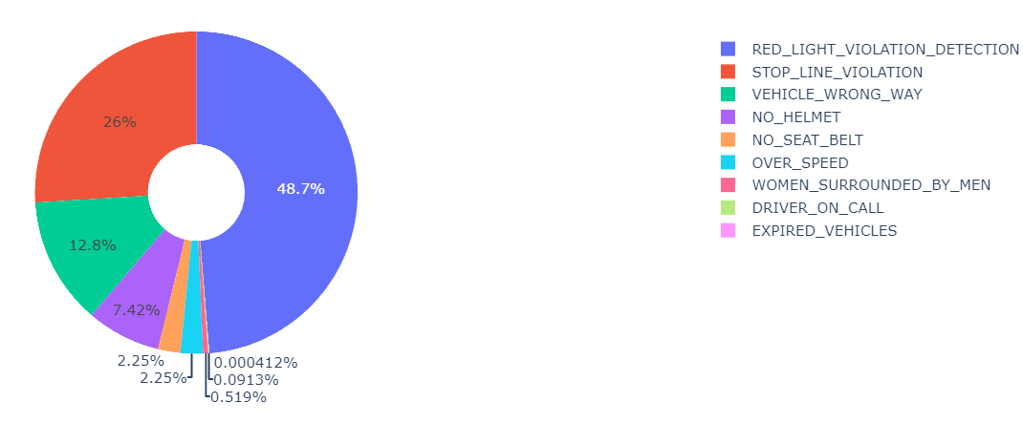
Updated Summary of Traffic Violation Frequencies
Violation Name | Frequency
RED_LIGHT_VIOLATION_DETECTION | 4,72,861
STOP_LINE_VIOLATION | 2,52,120
VEHICLE_WRONG_WAY | 1,24,085
NO_HELMET | 72,004
NO_SEAT_BELT | 21,841
OVER_SPEED | 21,802
WOMEN_SURROUNDED_BY_MEN | 5,042
DRIVER_ON_CALL | 886
EXPIRED_VEHICLES | 4

Slide 7
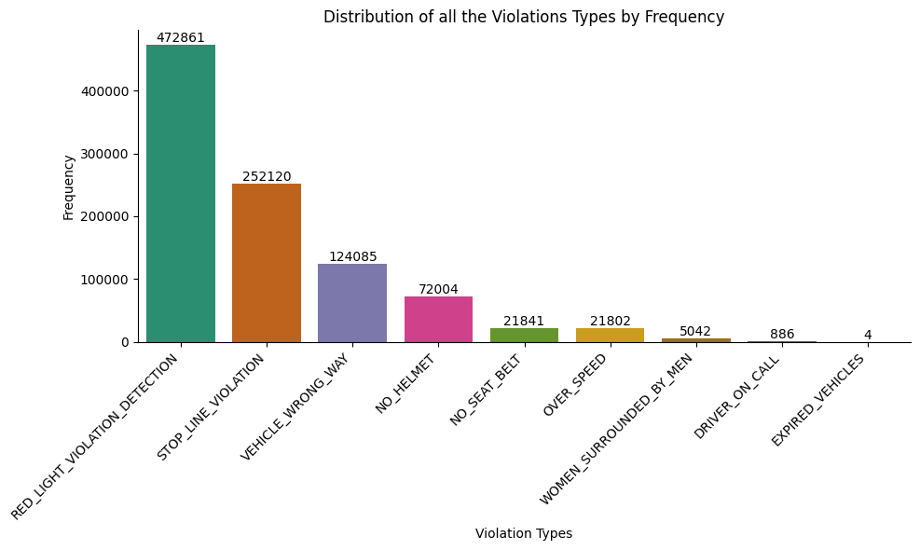
Distribution of Violations Types by Frequency

Slide 8
Distribution of Violations
We notice that the top 6 violations take up 99.92% of all Violation incidents!
Hence from here on we’ll consider only these 6 violations for our study.

Slide 9
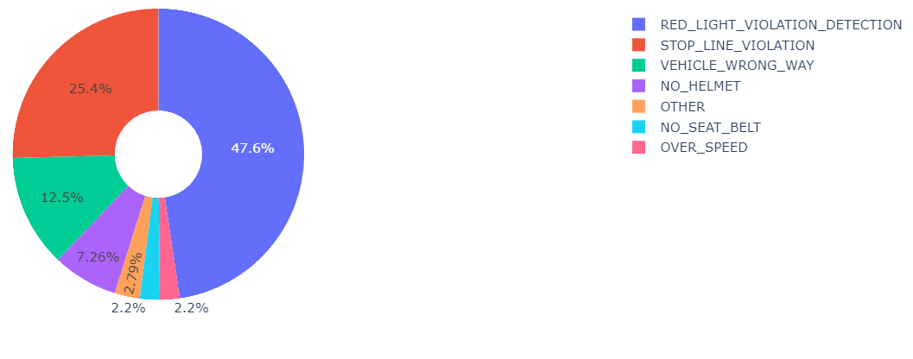
Distribution of Top 5 Violations

Slide 10
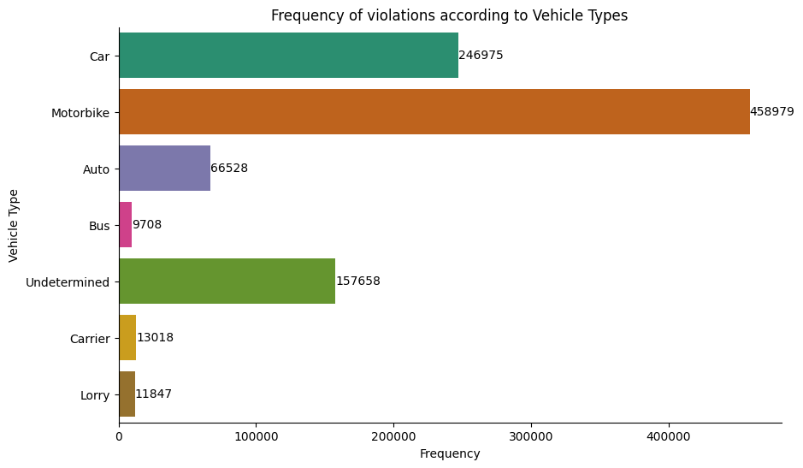
Frequency of Violations by Vehicle Types

Slide 11
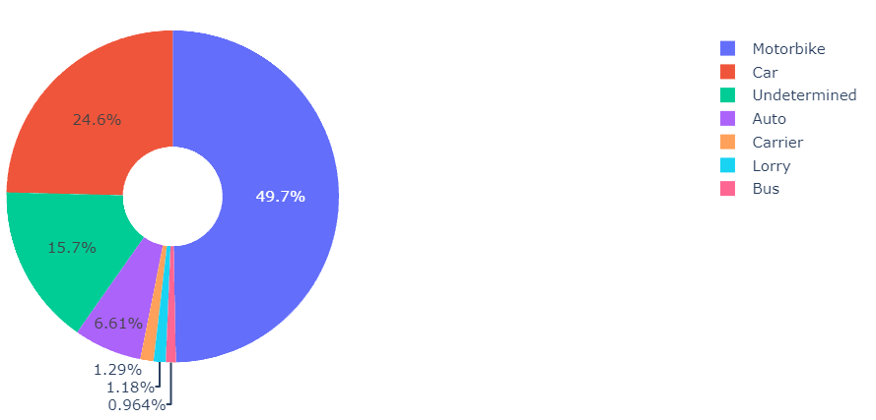
Distribution of Violations by Vehicle Type

Slide 12
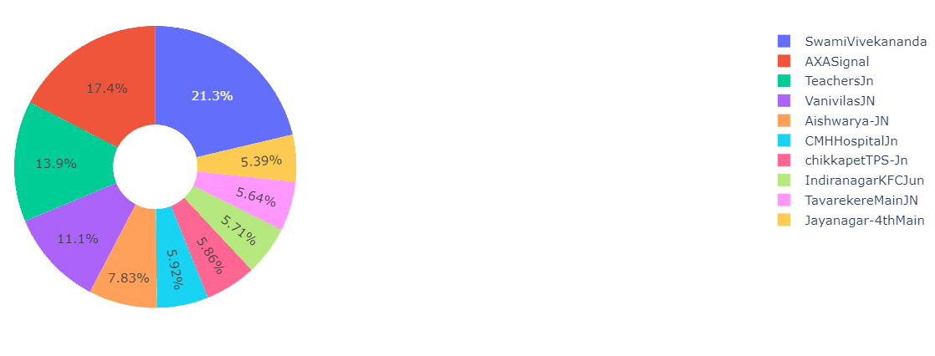
Distribution of Junctions with the most Violations
We notice that 5 locations namely , 'SwamiVivekananda', 'AXASignal', 'TeachersJn', 'VanivilasJN' and 'Aishwarya-JN' make up almost 72% of all the violations recorded! ->Key Locations

Slide 13
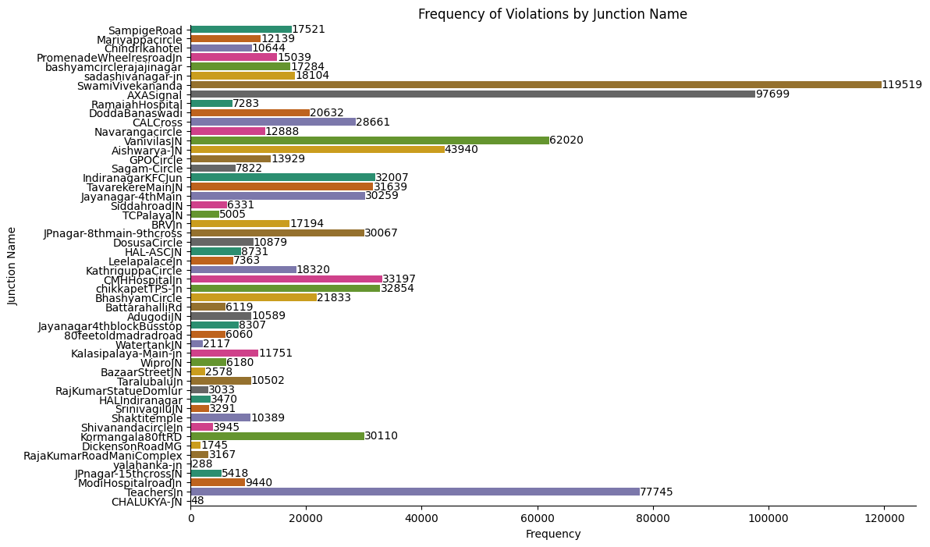
Frequency of Violations by Junction Name

Slide 14
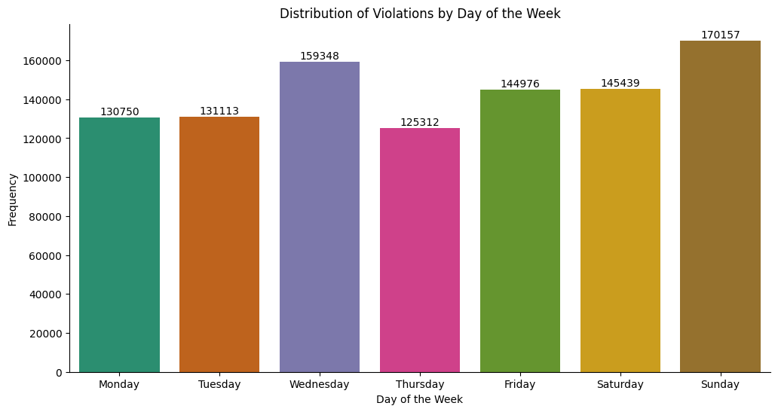
Temporal Analysis

Slide 15
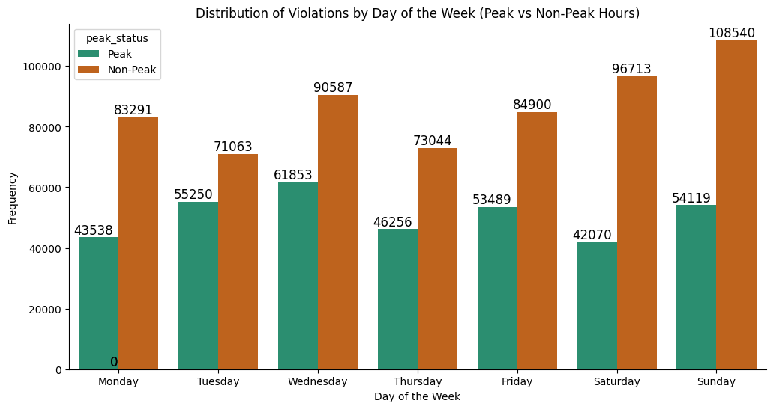

Slide 16
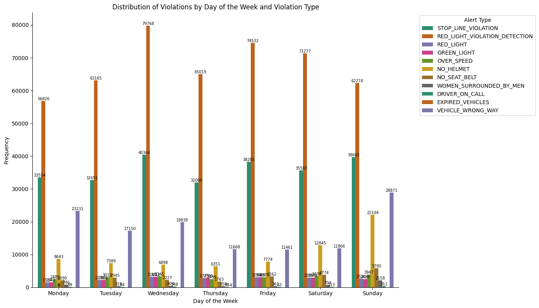

Slide 17
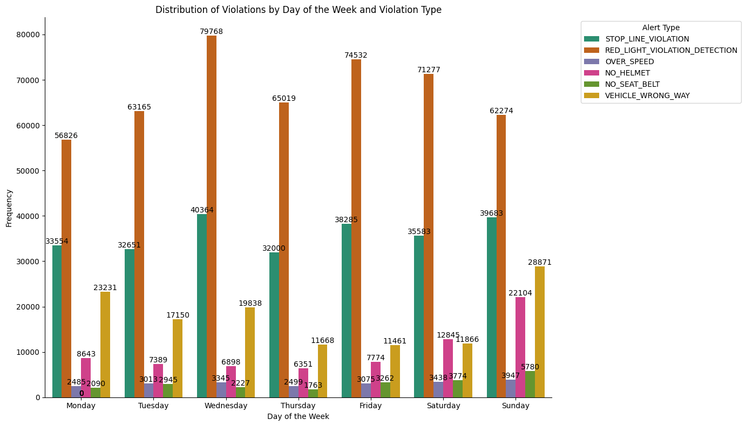

Slide 18
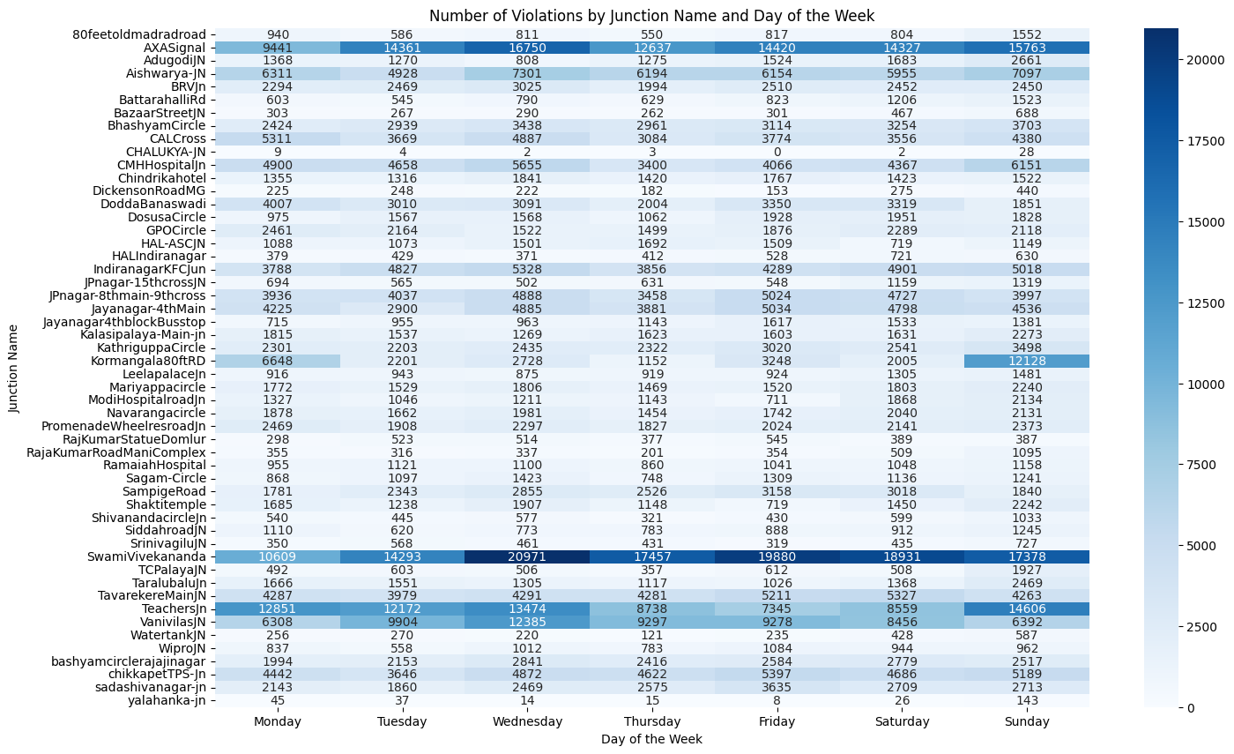

Slide 19
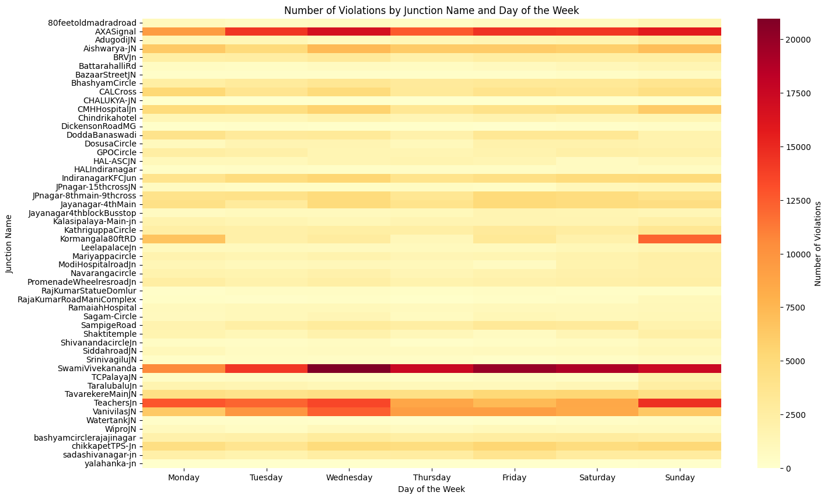
??

Slide 20
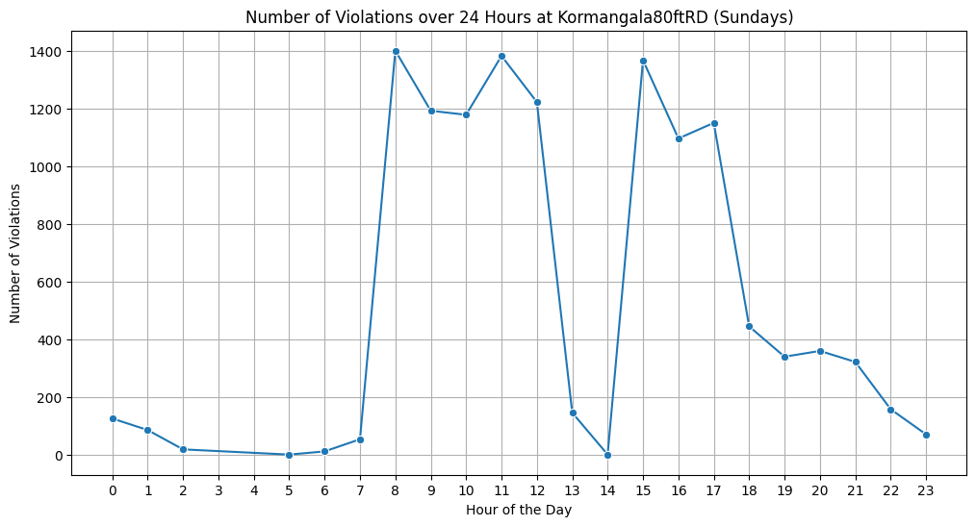
Let’s talk about this sudden spike in Kormangala

Slide 21
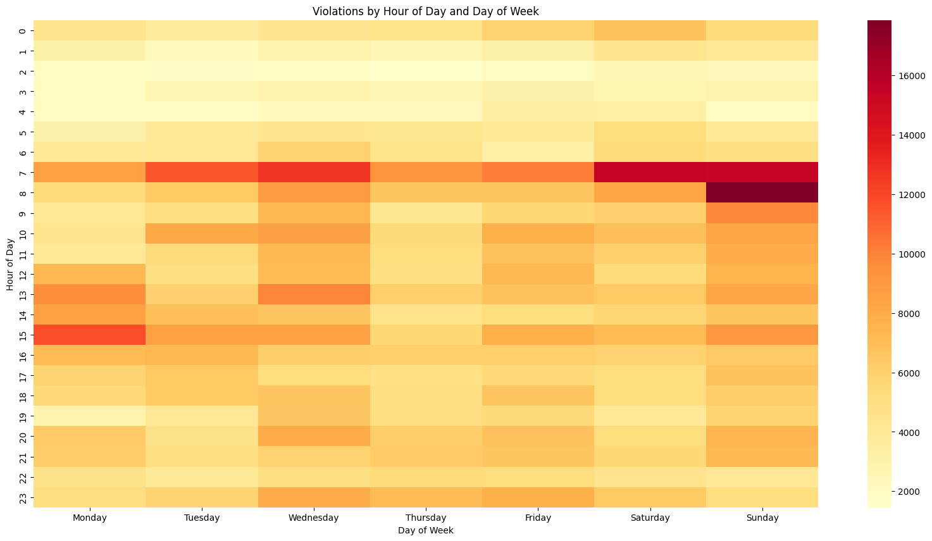

Slide 22
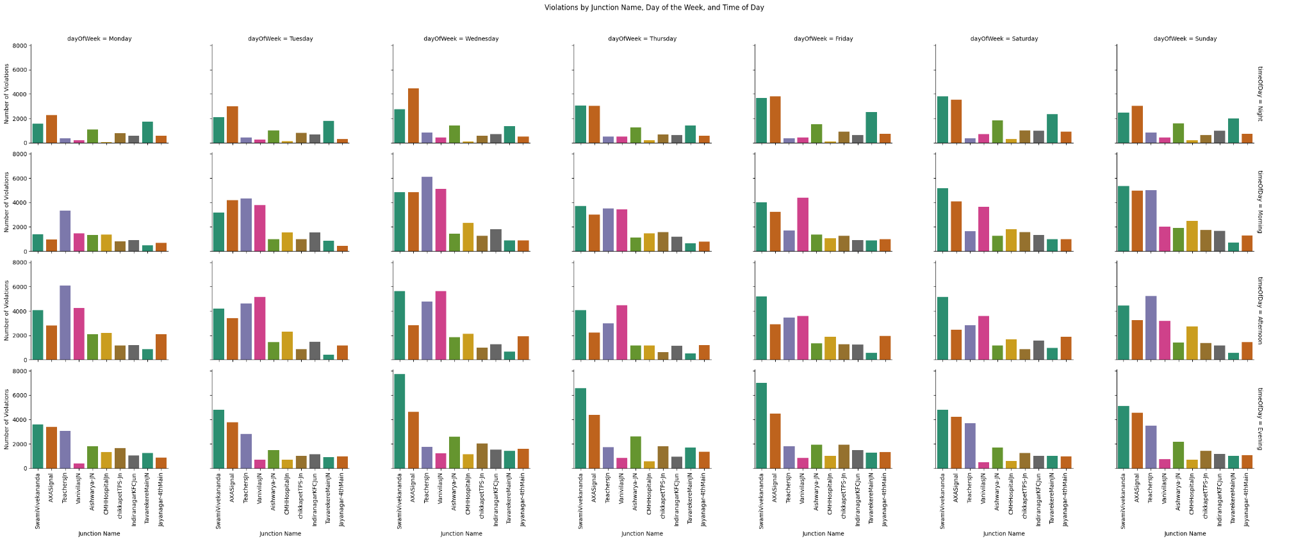

Slide 23
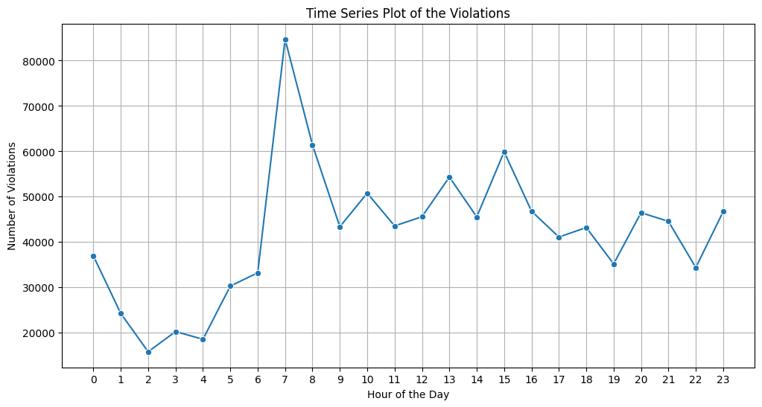

Slide 24
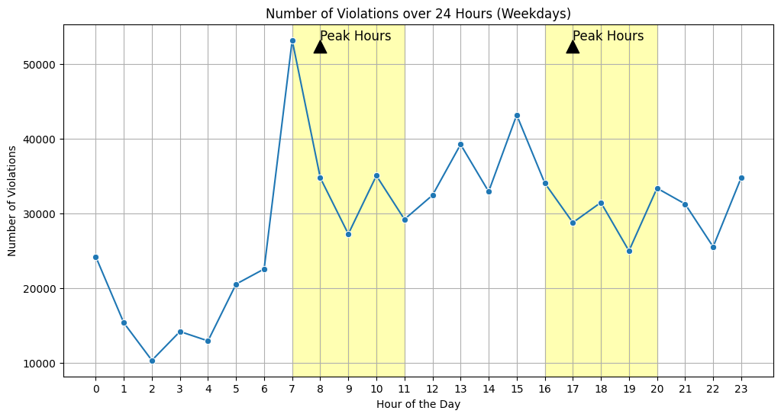
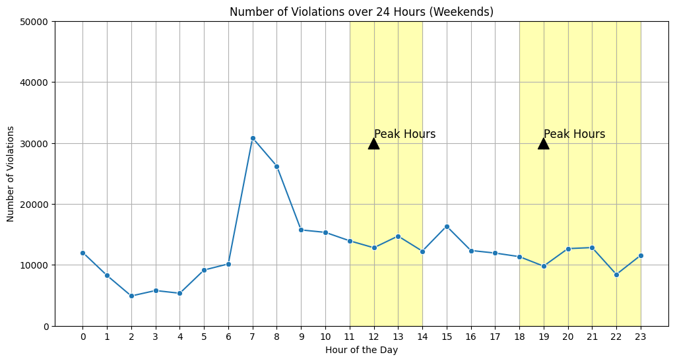
Weekdays vs Weekends
Peak hours and Non-peak hours as mentioned in the article by MN Anucheth

Slide 25
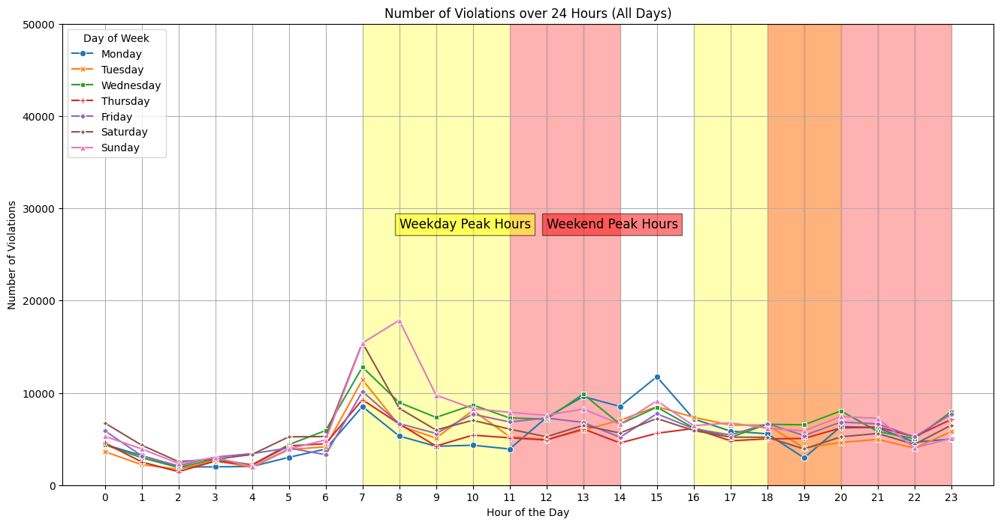

Slide 26
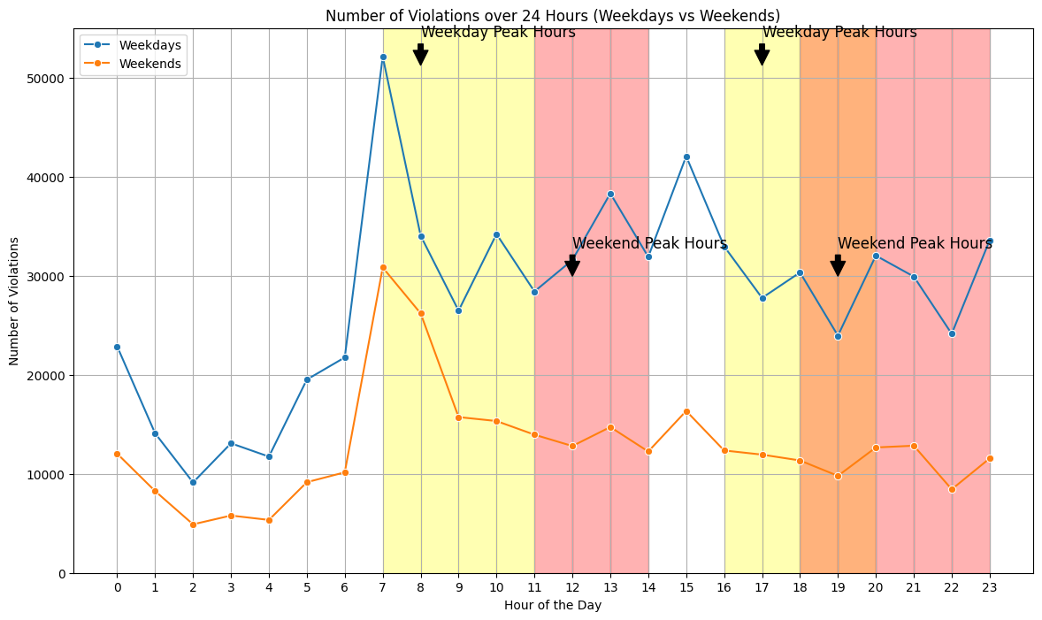

Slide 27
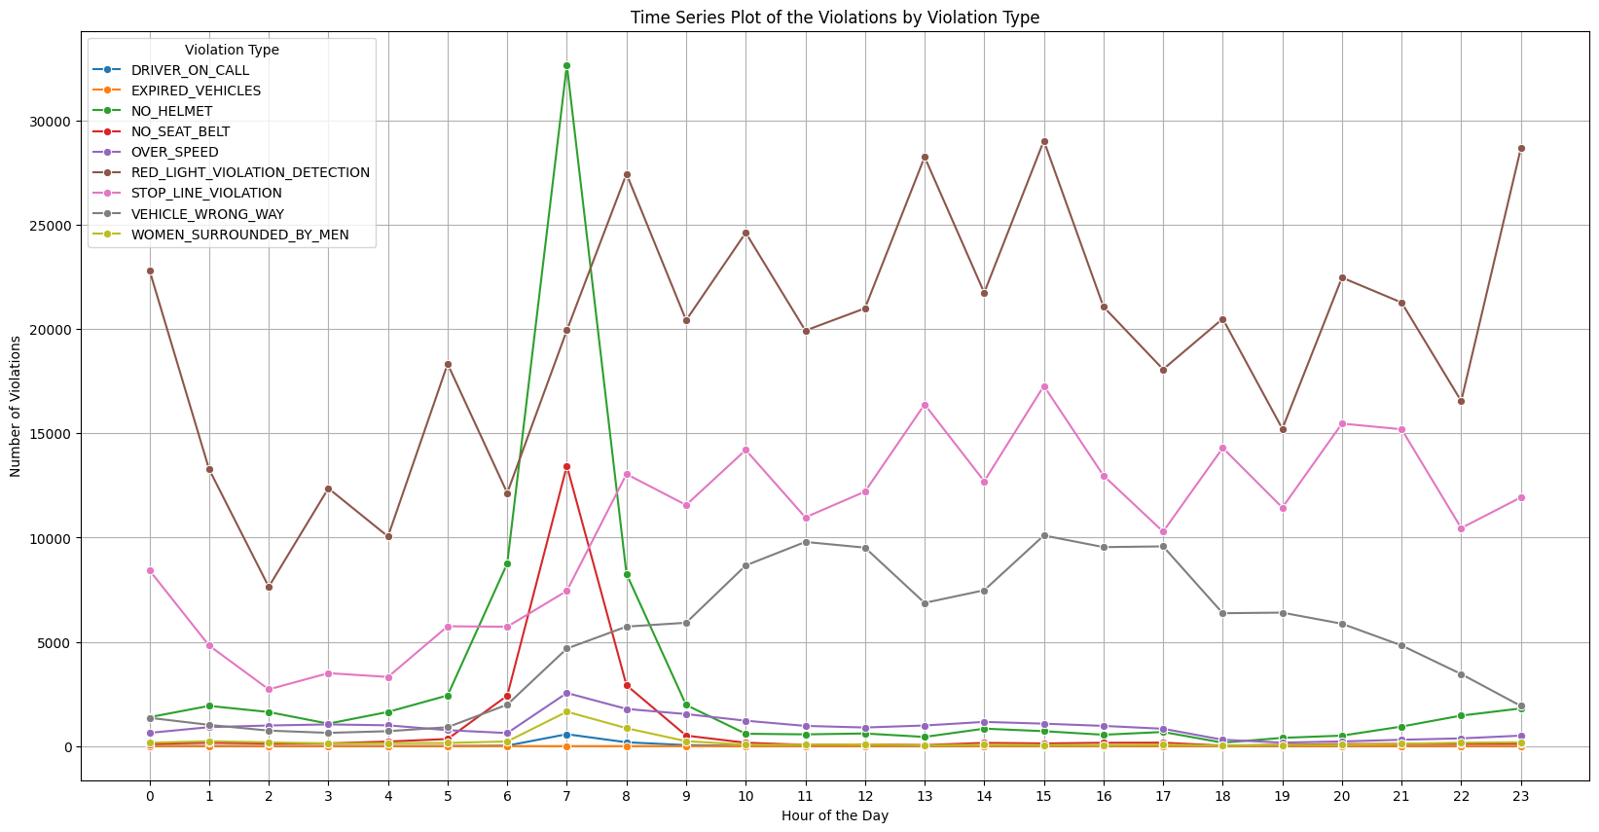

Slide 28
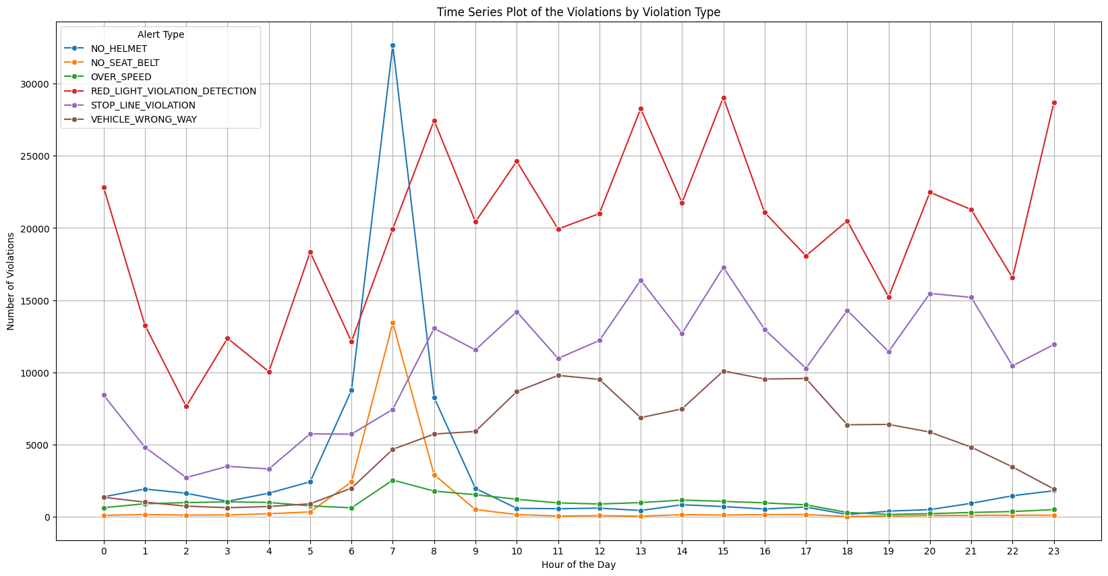

Slide 29
Key Insights
Cursory Analysis:
50 locations are considered, yet not all locations behave similarly in terms of violations both type and frequency.
RED_LIGHT_VIOLATION_DETECTION (47%) > STOP_LINE_VIOLATION (25%) > VEHICLE_WRONG_WAY (12.3%) > NO_HELMET (7.15%) > NO_SEAT_BELT (2.17%) ≈ OVER_SPEED (2.16%).
Motorbike (49.7%) >> Car (24.6%) > Undetermined (15.7%) > Auto (6.61%) > Carrier (1.29%) ≈ Lorry (1.18%) > Bus (0.96%).
SwamiVivekananda (21.3%) > AXASignal (17.4%) > Teacher’s Junction (13.9%) > Vanivilas Junction (11.1%) > Aishwarya Junction (7.83%)

Slide 30
Temporal Analysis:
Sunday has seen the highest number of violations followed by Wednesday and Friday. (Sunday > Wednesday >Friday ≈ Saturday> Tuesday ≈ Monday > Thursday ).
On analysing peak and non-peak hours of traffic (weekday peak: 7-11 AM and 4-8 PM) (weekend peak: 11AM-2PM and 6-11PM) we notice that there’s a huge disparity in terms of the frequency of these violations i.e. most of the violations are happening in the non-peak hours. And this is more than evident on weekends (Saturday and Sunday) where more than 2x violations are happening in the non-peak hours.
On observing the types of these violations by the day of the week-
A. Highest number of RED_LIGHT_VIOLATION_DETECTION on Wednesdays followed by Friday, with the lowest occuring on Mondays and Sundays.
B. While for STOP_LINE_VIOLATION we observe the peaks on Wednesdays and Sundays, with the lowest being on Thursdays and Tuesdays.
C. The VEHICLE_WRONG_WAY violation peaks abnormally on Sunday followed by Mondays with quite low such violations recorded on Thursday, Friday and Saturday.

Slide 31
Locations important for us monitor:
Spatial Analysis
SwamiVivekananda
AXASignal
Teacher’s Junction
Vanivilas Junction
Aishwarya Junction
These locations make up more than 70% of all violations in Bangalore!

Slide 32
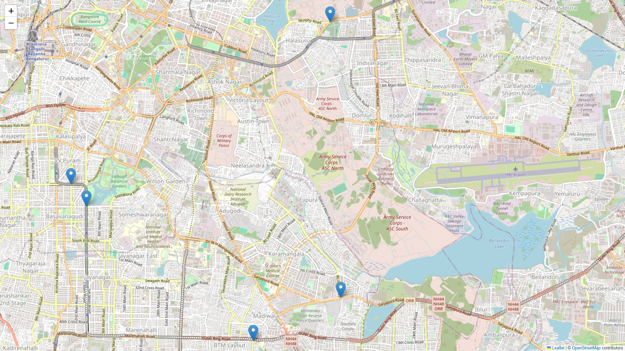
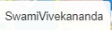
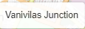
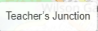
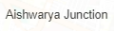
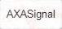
The 5 in-focus Intersections

Slide 33
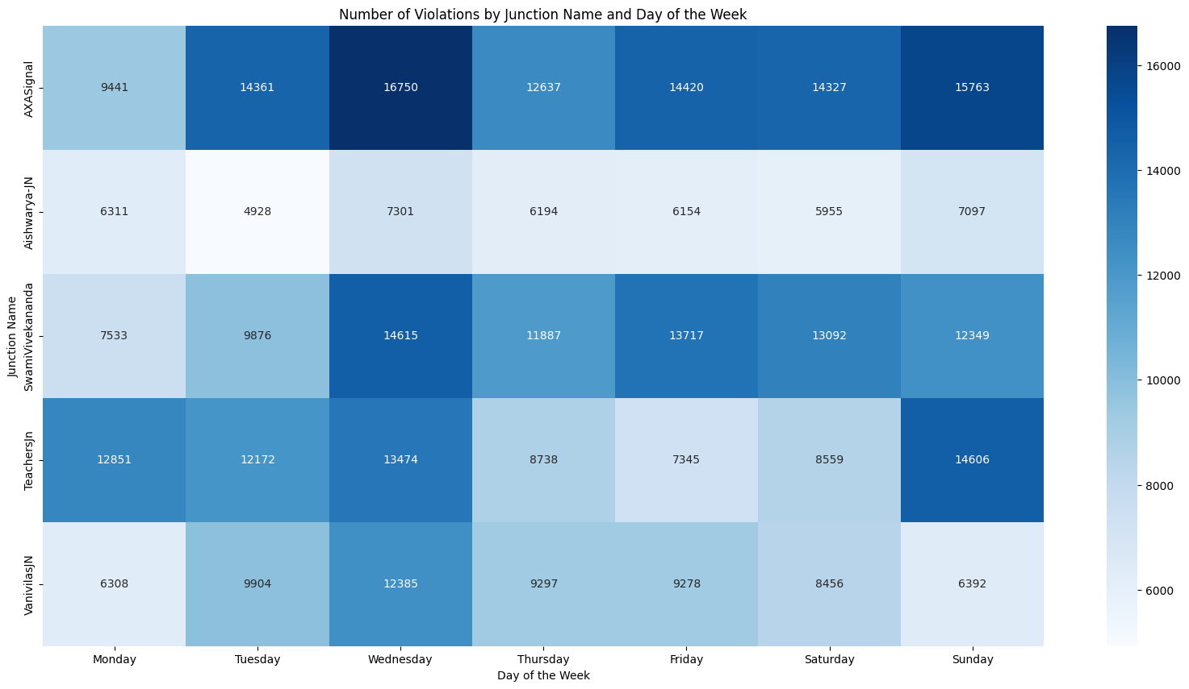

Slide 34
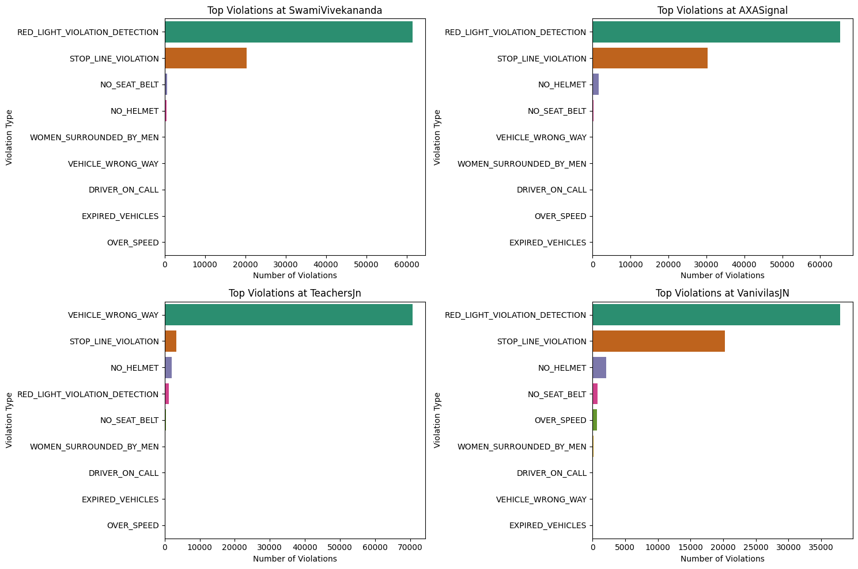
Top Violations at in-focus Junctions

Slide 35
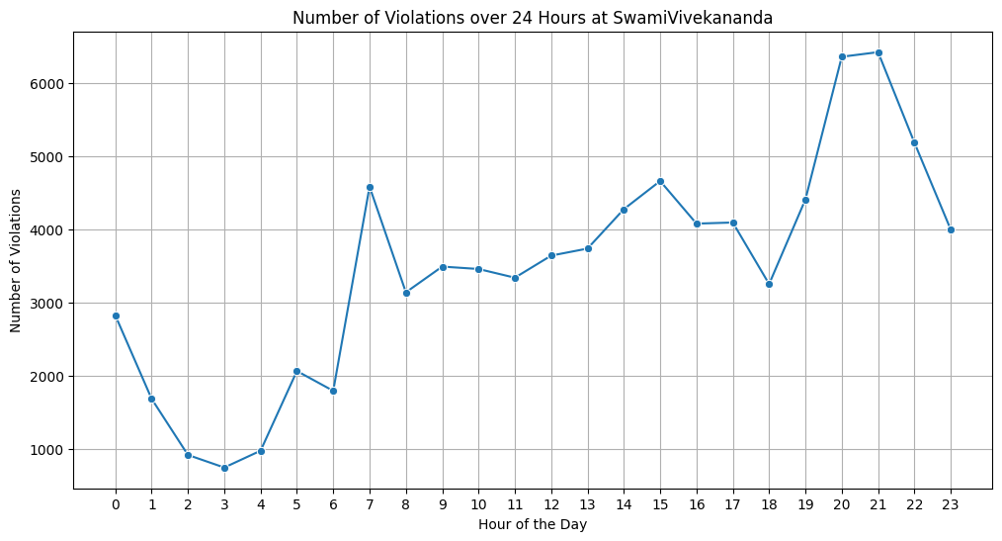
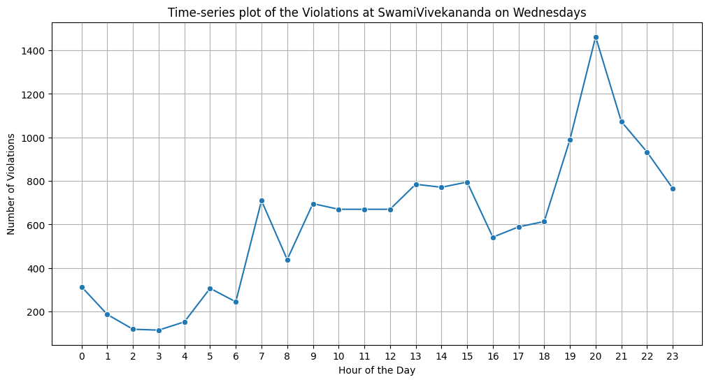
SwamiVivekananda
4. Highest number of violations are being observed at SwamiVivekananda on Wednesdays, the violations being RED_LIGHT_VIOLATION_DETECTION and STOP_LINE_VIOLATION. On observing the time-series trends of the junction, we observe that between 7-10 PM there is a sudden spike in the number of violations. Such spikes (but lower) are also observed between 6-8AM and 12-3PM as well.

Slide 36
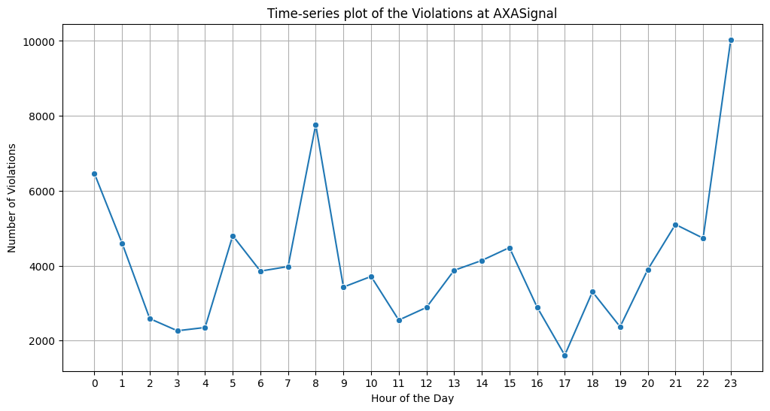
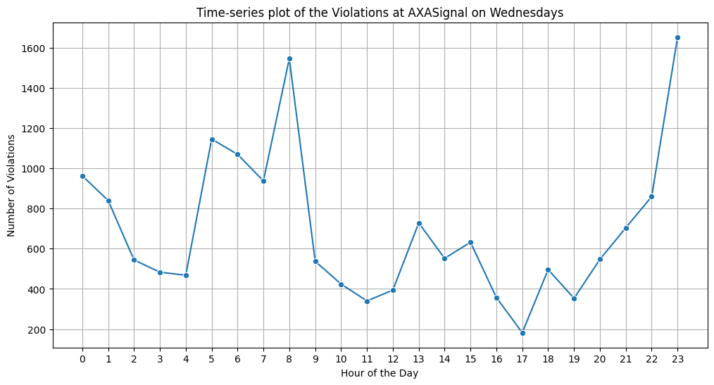
AXASignal
5. Highest number of violations at AXASignal are again due to RED_LIGHT_VIOLATION_DETECTION and STOP_LINE_VIOLATION on Wednesdays and Sundays. On observing the time-series trends of the junction, we observe that between 10PM-12AM there is a sudden spike in the number of violations. Such spikes (but lower) are also observed between 5-9AM.

Slide 37
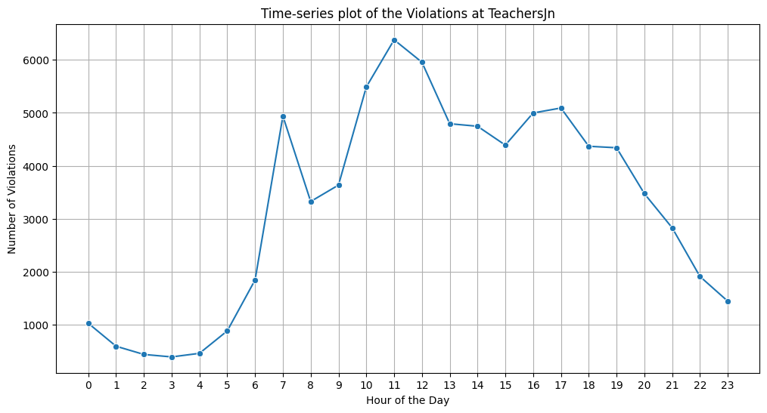
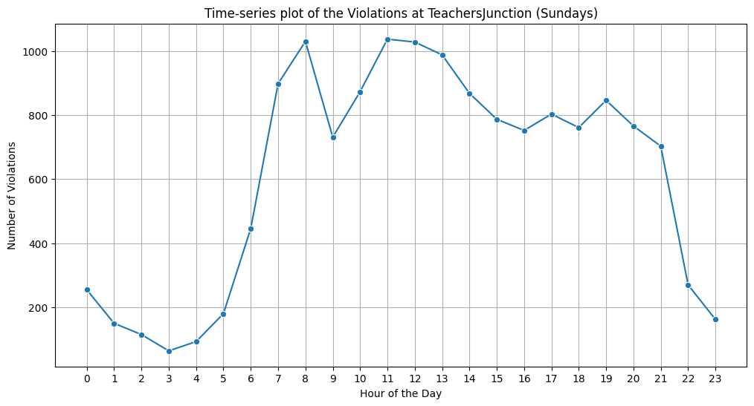
Teacher’s Junction
6. Highest number of violations at Teacher’s Junction are due to VEHICLE_WRONG_WAY on Sundays. On observing the time-series trends of the junction, we observe that between 6-8AM and 10AM-1PM there is a sudden spike in the number of violations. The violations reduce drastically after 5PM.

Slide 38
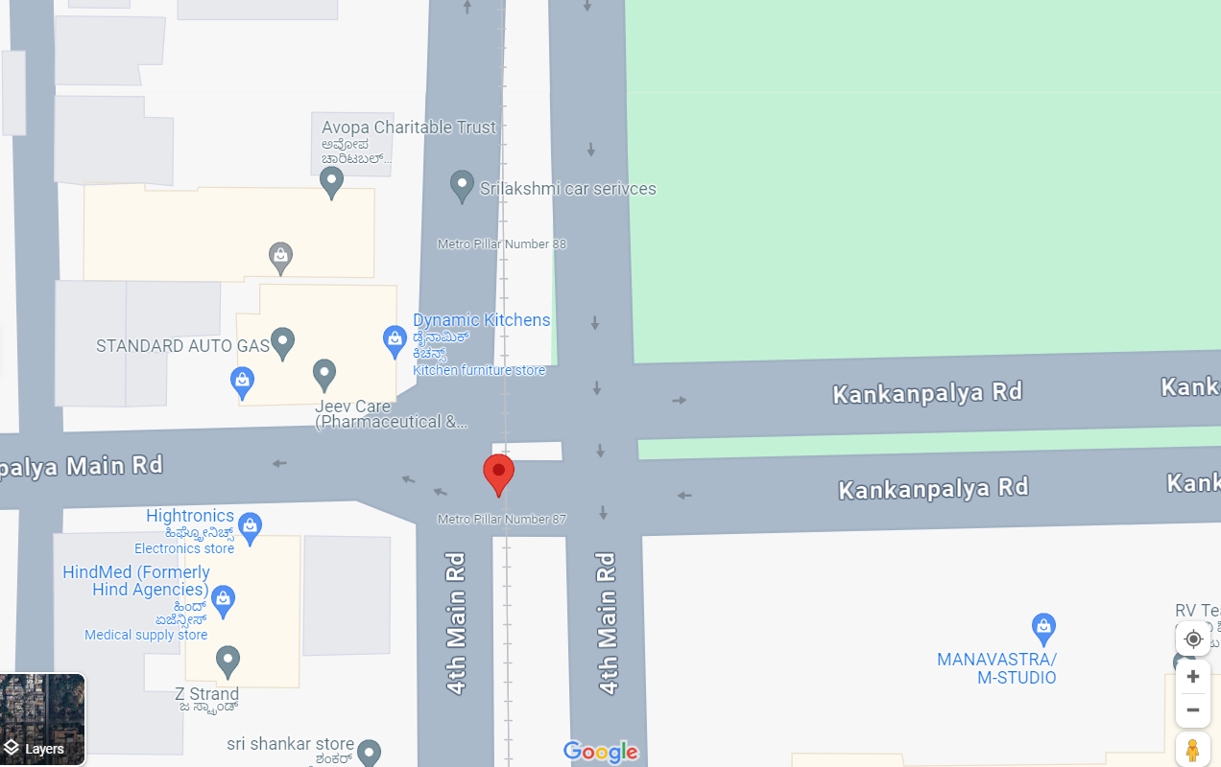
Need reasons for VEHICLE_WRONG_WAY?

Slide 39
Problem with the Peak and Non-Peak Surveillance
Weekday peak: 7-11 AM and 4-8 PM
Weekend peak: 11AM-2PM and 6-11PM
It is evident from the visualizations that peak hours are not matching up with the number of violations during these hours.
During the weekdays the violations start with an upward trend post 6AM. But as the peak hours kick-in the violations do reduce (maybe due to increased TP personnel). But as the non-peak hours hit, the violations instead of reducing or plateauing rather show an upward trend till 3PM and as the peak hours commence again, the violations again reduce (lowest during the day).
For the weekends, we observe an even drastic trend. Where the peak hours were considered to have shifted, the violations are still spiking between 6-9AM and reduce progressively irrespective if the actual peak hours.
This proves that peak and non-peak hours have been decided solely based on traffic during these hours but the number of violations do not really follow the same trend and once the TP personnel exit, the violations anyway rise.

Slide 40
Scope for Future Work
These were the 5 viable features available to us-
Vehicle Type
Violation Type
Observation Date Time
Junction Name
Violation Coordinates
For more in depth and data driven analysis more features would come in handy, like- A. Weather Factors B. Space Factors (Land Use) C. Cycle Length

